Slide 1
Same answer, different thoughts.
TWO IDENTICAL RESUMES · ONLY THE NAME CHANGES
Emily
YES
Lakisha
YES
Both pass an output audit. Inside, the model still leans on the name.
Notes:
8 seconds. "Two resumes, identical except the name. The model says yes to both, so an answer-only audit passes it. But the same answer can hide different thoughts."

Slide 2

A hiring model that checks itself for both kinds of bias
OUR PROOF OF CONCEPT
It counts as fair only if all three hold:
BEHAVIOURAL BIAS
What it says: swap only the name. Does the shortlist decision change?
Fair answers
Shortlist gap between White- and Black-coded names near 0
No bias left inside, at any late layer
Every one of layers 16–23 at or below a clean model, not just the last
ACTIVATION-SPACE BIAS
Still good at hiring
What it thinks: is there a name direction in any of its 24 layers?
For both name groups, on 60 CVs it never saw
Notes:
12 seconds. "So our tool checks itself two ways: what the model says, does the shortlist change with the name, and what it thinks, is the bias still inside, layer by layer. It only counts as fair if it passes both and is still good at hiring."

Slide 3
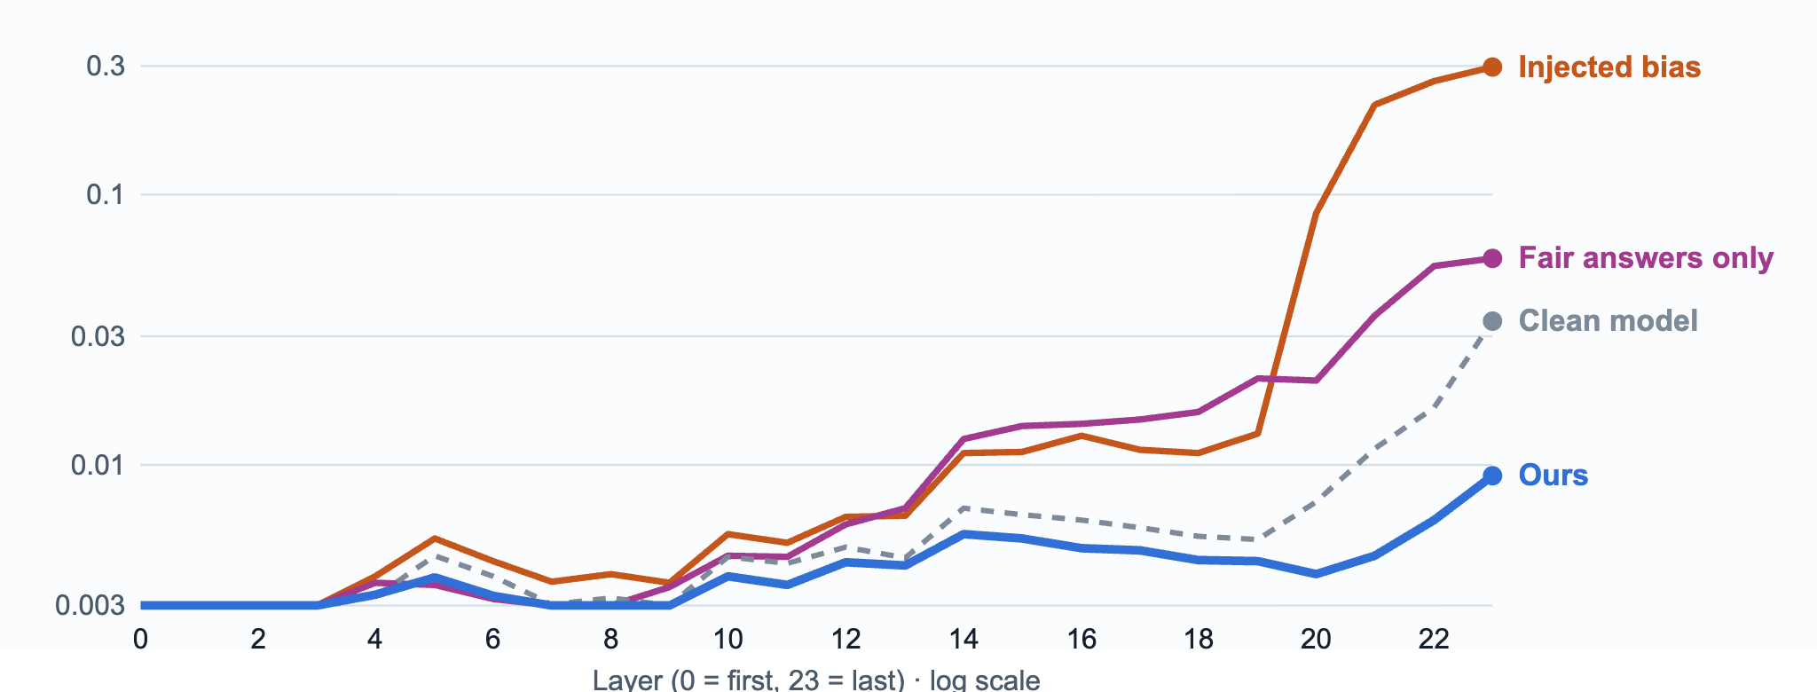
Fixing answers alone hides the bias. Ours brings every late layer to clean.
HOW WE FIXED IT · THREE APPROACHES, ONE PASSES
1 · Project it out
2 · Retrain on fair answers
3 · Retrain + same activations
Delete the name direction while it runs
Teach Yes/No labels that ignore the name
Also make Emily and Lakisha look identical inside
No retraining. 39–49% of the late-layer bias stays: the model routes around the cut. A fast patch, not a cure.
Gap 0.03, so it looks fixed. But late layers keep 2.6× a clean model's bias. The trap most fixes fall into.
Penalise any activation difference, at every layer. Gap 0.00, late layers below a clean model, accuracy 0.95.
Activation-space bias by layer (Hannah's activation differential), 60 held-out resumes, Qwen2.5-0.5B with injected bias.
Notes:
18 seconds. "We injected bias: qualified White names were shortlisted 93 points more often than Black names. Retraining on fair answers, in purple, looks fixed, but its late layers still carry 2.6 times a clean model's bias. Our fix, in blue, trains the model to think the same about both names: every late layer at or below a clean model." If asked how: step 1 subtracts the name direction at inference (Mal's erase fixes); step 2 retrains on name-independent Yes/No labels; step 3 adds a loss on the activation difference between the Emily and Lakisha versions at every layer (retrain_fix.py, lambda 2). Step 3 stops the model computing the name signal, not just using it.

Slide 4
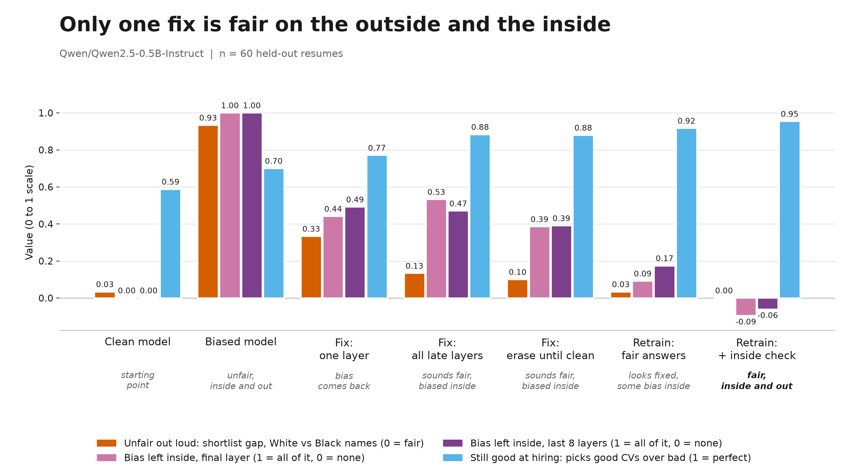
The self-check passes only our fix. Gap 0.93 → 0.00.
Fix | 1 · Fair answers (gap) | 2 · Inside: late layers vs clean | 3 · Good at hiring (W / B) | Verdict
Usual fix: erase all late layers | 0.13 fail | 5.2× fail | 0.88 / 0.89 pass | Refused
Retrain: fair answers only | 0.03 pass | 2.6× fail | 0.91 / 0.93 pass | Refused
Retrain: + same thoughts (ours) | 0.00 pass | 0.46× pass | 0.95 / 0.96 pass | Passes
Clean model: gap 0.03. Late layers = 16–23, pooled, as a multiple of a clean model's bias. Pass lines are our policy choice. 60 held-out CVs. On this model, under these tests.
Notes:
14 seconds. "Our tool checks itself, so it can tell these fixes apart. The usual erasure fix leaves 53 percent of the bias inside. Only ours passes all three: gap zero, every late layer at or below a clean model, and accuracy up from the biased model's 0.70. On this model, under these tests." Don't say "eliminated", don't claim it beats fair-answers retraining on accuracy (0.95 vs 0.92 is noise). Q&A: a probe still reads the name a little (0.65–0.77), less than a clean model; knowing a name isn't bias, using it is.

Slide 5
What we don't claim
LIMITS
One small model
Only what we test
Qwen 0.5B, 60 held-out resumes. Results won't transfer between models.
The fix covers name swaps. Other proxies need their own pairs. No test proves zero bias.
Names only
Injected bias
A crude proxy for race. University, postcode and career gaps leak too.
Cleaner than real-world bias. Pass lines were set after seeing results.
Notes:
8 seconds. "Limits: one small model, names as the only signal, and an injected bias. So the tool re-checks every model and every update."

